Slide 1
QTP Training (Advanced)
Shanmugadas.C.S
Created On : 04-10-2005

Slide 2
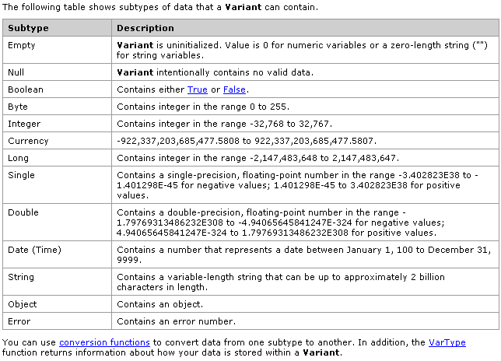
VB Script basics – Data Types

Slide 3
VB Script basics – Variables & Constants
Declaring Variables
Naming Restrictions
Scope and Lifetime of Variables
Assigning Values to Variables
Scalar Variables and Array Variables
Creating Constants

Slide 4
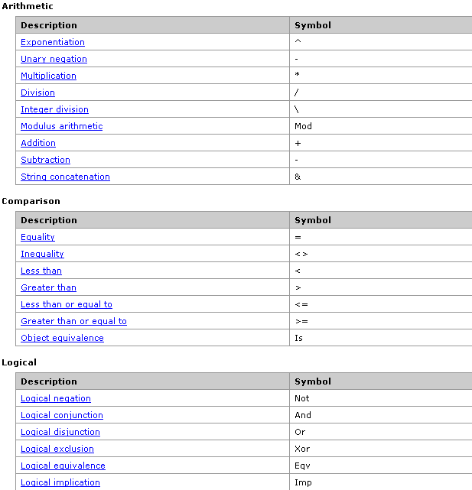
VB Script basics - Operators

Slide 5
VB Script basics – Conditions & Looping
Conditional Statements
  If...Then...Else statement
  Select Case statement
Looping
  Do...Loop: Loops while or until a condition is true.
  While...Wend: Loops while a condition is true.
  For...Next: Uses a counter to run statements a specified number of times.
  For each...Next: Repeats a group of statements for each item in a collection or each element of an array.

Slide 6
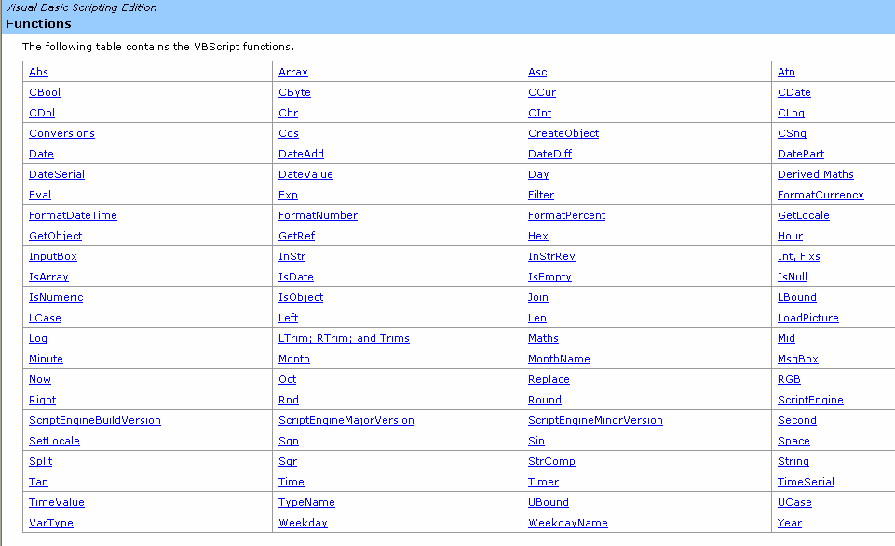
VB Script basics – Functions

Slide 7
Key areas in QTP
About the script structure
Object Identification Mechanism
Active screen customization
Actions (Simple, Nested, External, Re-usable)
Parameterization (Different Types)
Checkpoints (Programmatic Methodology)
Descriptive programming
Adv. Synchronization points
Exception Handling
Microsoft Automation Object Model

Slide 8
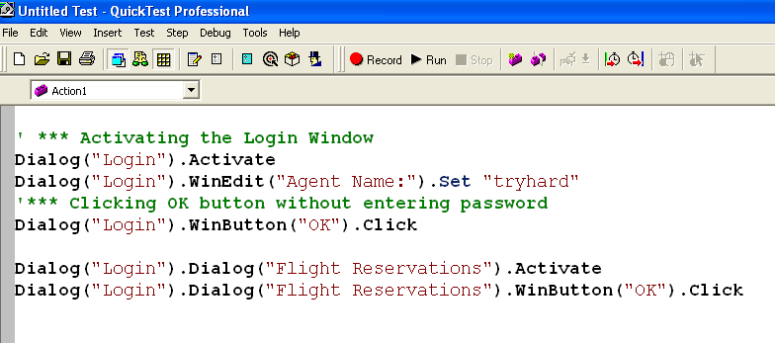
About the script structure

Slide 9
Sample Script – QTP Functions
‘sample 1 - Capturing the snapshot of the combo box control
Window("Flight Reservation").WinComboBox("Fly From:").CaptureBitmap "C:\mybmp.bmp",true
'sample 2 - Capturing the snapshot of the entire window
Window("Flight Reservation").CaptureBitmap "C:\mybmp.bmp"
'sample 3 - Getting all the items from the combo box
My_Cnt = Window("Flight Reservation").WinComboBox("Fly From:").GetItemsCount
msgbox My_Cnt
For i = 1 to My_Cnt
' the combo box item index will start from zero.
My_item = Window("Flight Reservation").WinComboBox("Fly From:").GetItem(i-1)
Msgbox My_item
Next
'sample 4 - Getting the entire content of the combo box
Var_Content = Window("Flight Reservation").WinComboBox("Fly From:").GetContent
Msgbox Var_Content

Slide 10
Sample Script – QTP Functions
'sample 5 - Selecting an item from the combo - Using Index
Window("Flight Reservation").WinComboBox("Fly From:").Select(5)
'sample 6 - Selecting an item from the combo - Using Value
Window("Flight Reservation").WinComboBox("Fly From:").Select("London")
'sample 7 - Selecting an item from the combo - Using Variable
Var_Item = "Zurich"
Window("Flight Reservation").WinComboBox("Fly From:").Select(Var_Item)
'sample 8 - Getting the value of selected item
Var_Sel = Window("Flight Reservation").WinComboBox("Fly From:").GetSelection
Msgbox Var_Sel

Slide 11
Sample Script – QTP Functions
'sample 9 - Edit box functions
Window("Flight Reservation").Activate
Call wait(8)
Window("Flight Reservation").WinEdit("Name:").Set "DasDas“
Call wait(8)
Window("Flight Reservation").WinEdit("Name:").Type "tryhard“
Call wait(8)
Window("Flight Reservation").WinEdit("Name:").Set "DasDas“
Call wait(8)
Window("Flight Reservation").Activate
Call wait(8)
Window("Flight Reservation").ActiveX("MaskEdBox").Set "111111“

Slide 12
Sample Script – QTP Functions
' Some FUM's (Frequently Used Methods)
'GetROProperty
Var_Text = Window("Flight Reservation").WinEdit("Name:").GetROProperty("AttachedText")
Msgbox Var_Text
Var_Enab = Window("Flight Reservation").WinEdit("Name:").GetROProperty("Enabled")
Msgbox Var_Enab
'Exist
If Window("Flight Reservation").WinEdit("Name:").Exist(5) Then
Msgbox "The Editbox exists"
Else
Msgbox "The Editbox does not exist"
End if
'Wait
Wait(10) ' The QTP will sleep for 10 seconds
'Msgbox
Msgbox "Hello QTP"

Slide 13


Tea Break?

Slide 14
Object Identification Mechanism
Object Identification
  Simple script for object identification
  Renaming the logical name (‘ok’ to ‘cancel’)
  Change the text property of the control (“OK” to “Cancel”)
  Properties to be avoided in Mandatory Prop List (“Hwnd”,“OK_2“)
  Class Identification Mechanism (e.g. Winbutton up to the first level hierarchy QTP can classify)
User Defined & Virtual Objects
  Demo on User Defined objects and mapping them with the standard class
  Demo on virtual objects…

Slide 15
Active screen customization
Demo
  Setting up the active screen with different options

Slide 16
Actions (Simple, Nested, External, Re-usable)
Standalone Actions
Nested Actions
Integration of Actions (Call from One Action to other)
Driver Action (Main Action)
Re-usable Actions
External Call for Actions
Action Parameter

Slide 17
Parameterization
Classifications of Parameterization
  Test and Action Parameters
  Data Table (Global & Action Specific)
  Environment variables
  Random Number
Demo on data table parameter using two parameters

Slide 18
Checkpoints (Programmatic Methodology)
Demo on checkpoints
  Standard checkpoint
  Update run

Slide 19
Descriptive Programming
Demo on descriptive programming
  Entering Programmatic Descriptions Directly into Statements
  Browser("Mercury Tours").Page("Title:=Mercury Tours").WebEdit("Name:=Author", "Index:=3").Set "Mark Twain"
  Using Description Objects for Programmatic Descriptions
  Set MyDescription = Description.Create()
  MyDescription("text").Value = "OK"
  MyDescription("width").Value = 50
  Window("Error").WinButton(MyDescription).Click

Slide 20
Adv. Synchronization Points
Demo: using tool menu options
Demo: wait property
Demo: programmatically
Demo: wait & exist

Slide 21
Exception Handling
Recovery Scenario Concepts
Recovery Process
  Trigger Events
  Recovery Operation
  Post-recovery Operation
Demo

Slide 22
Automation Object Model
AOM Usage:
  Users can use these objects, and their associated methods and properties, to write the
  programs that automatically configure Quick Test options and run tests
Explanation and demo on Object model

Slide 23
Day Break?

